Slide 1


Introduction
ACCESSDATA® FORENSICS
Windows Registry 101
Forensic Analysis
Incident Response
eDiscovery
Information Assurance

Slide 2
Module Objectives
The Registry (in 25 words or less)
NT Sytesms Registry Files
Registry “Hives, Keys, and Values”
Multiple Profile Issues

Slide 3
The Registry
A central repository for:
  User information (currently logged on)
  System information (currently detected)
Stored in registry files:
  Application information
  Specific user preferences
  System hardware settings
  (Ok, that was 25 words)

Slide 4
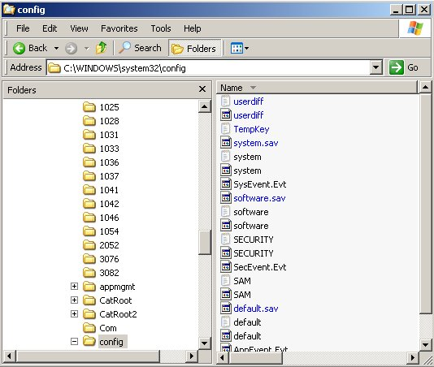
XP Registry Files
SAM
SYSTEM
SECURITY
SOFTWARE
And don’t forget each user’s → NTUSER.DAT
XP and all NTFS

Slide 5
Registry “Hives”
Come together to create:
HKEY_CLASSES_ROOT (HKCR)
HKEY_CURRENT_USER (HKCU)
HKEY_LOCAL_MACHINE * (HKLM)
HKEY_USERS * (HKU)
HKEY_CURRENT_CONFIG (HKCC)
(HKEY is the programming handle to a key)
Notes:
The Windows registry consists of six root keys, each of which contains configuration data that is both user and hardware specific.
HKEY_CLASSES_ROOT
This key points to the HKEY_LOCAL_MACHINE\Software\Classes registry key, which describes certain software settings. This key displays essential information about OLE and association mappings to support drag-and-drop operations, Windows shortcuts (which are OLE links), and core aspects of the Windows user interface.
HKEY_CURRENT_USER
This key contains user-specific settings that are built from information in the HKEY_USERS key during the logon process.
HKEY_LOCAL_MACHINE
This key contains computer-specific information about the type of hardware installed and software settings. This information is used for all users who log on to the computer. This key has several subkeys.
HKEY_USERS
This key contains information (generic and user-specific) about all the users who log on to the computer. The generic settings are available to all users who log on to the computer. The information is made up of default settings for programs, desktop configurations, and so on. This key contains subkeys for each user that logs on to the computer.
HKEY_CURRENT_CONFIG
This key handles Plug and Play and contains information about the current configuration of a multiple hardware configuration computer (for example, settings for a docking station). This key is a pointer to one of the configuration keys of the HKEY_LOCAL_MACHINE\Config key; the configuration key (000x for example, 0001) that contains information about the current configuration of hardware attached to the computer.
HKEY_DYN_DATA
Dynamic data (data stored in RAM on the computer) is contained in this key. This information may change as devices are added or removed from the computer. The information for each device includes the related hardware key and the device's current status, including problems. Device Manager uses this data to show the current hardware configuration, and this data is used to constantly update System Monitor.
Re: Microsoft knowledge Base Article: 250409 http://support.microsoft.com/?kbid=250409

Slide 6
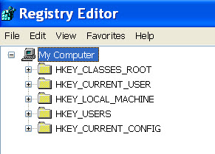
Registry “Hives”
These keys:
  HKEY_CLASSES_ROOT (HKCR)
  HKEY_CURRENT_USER (HKCU)
  HKEY_CURRENT_CONFIG (HKCC)
Are derived from these keys:
  HKEY_LOCAL_MACHINE (HKLM)
  HKEY_USERS (HKU)
Notes:
The question becomes:
Can you search for the file “HKEY_CURRENT_USER” on a suspect hard drive.
The answer is:
No, these registry “keys” only exits while Windows is running – was Windows shuts down, they separate back into SYSTEM.DAT and USER.DAT(s).
Or if one user logs out and another user logs in, the corresponding USER.DAT is loaded and used accordingly.

Slide 7
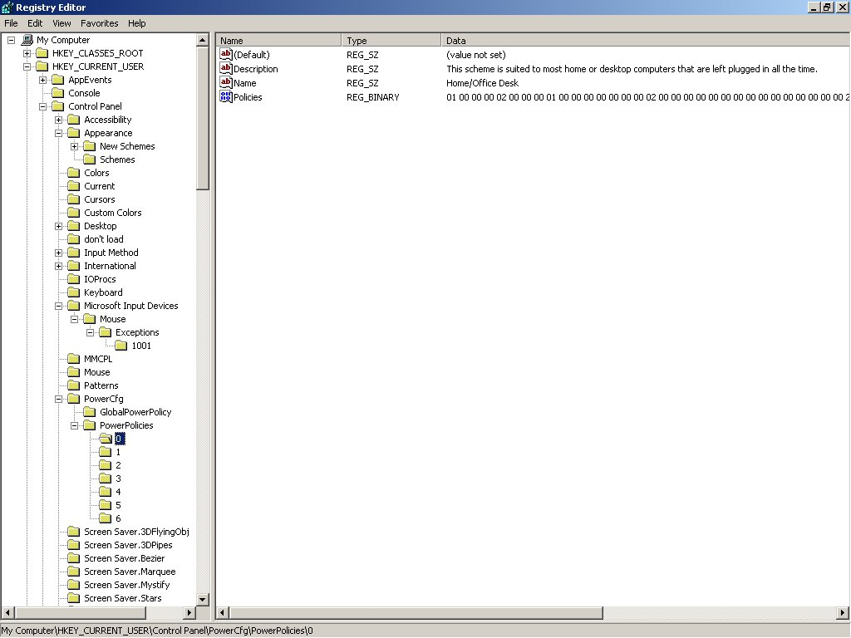
Registry Navigation
Note the “tree” structure similar to Windows Explorer. Note also:
Hive
Key
Values

Slide 8

Registry Values
Note the REG_SZ (String) values
Note the REG_BINARY (?) values
These value types will influence our
processing and documentation methods

Slide 9
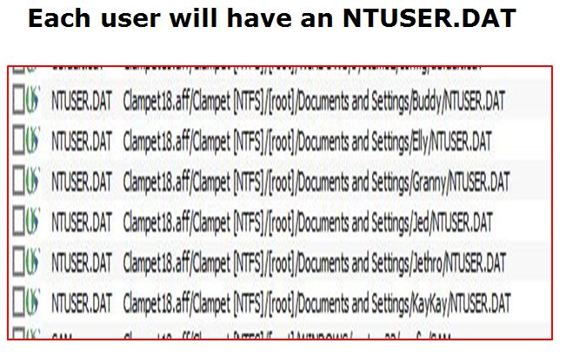
Multiple Profile Issues

Slide 10
Module Review
The Registry (in 25 words or less)
NT Systems registry Files
Registry “Hives, Keys, and Values”
Multiple Profile Issues

Slide 11



